Slide 1

Online Shoppers Intention
Dhamastya Adhi
Dimas Pulung Herjuno
Estri Puji Lestari

Slide 2
Business Understanding
Problem : We do not know what kind of user behavior indicates that the user is interested in the site visited
Clear Question : Does a user who visits a particular page on the website show a positive interest in the website?
Measurable Outcome : Type of customer based on their behavior
Notes:
Mencari taget customer berdasarkan perilaku online shopping

Slide 3
Analytical Approach
K-Means Clustering
K-Means is unsupervised ML.
We use this model because we want to comparing user behavior with grouping them into cluster.

Slide 4
Data Requirement
The amount of pages visited in the certain categories as well as the total time spent on each of these categories
Some of User Engagement KPI from Google Analytics such as bounce rate and exit rate as the indicator of website’s success
Revenue : Is the user contributing on revenue after visiting e-commerce?

Slide 5
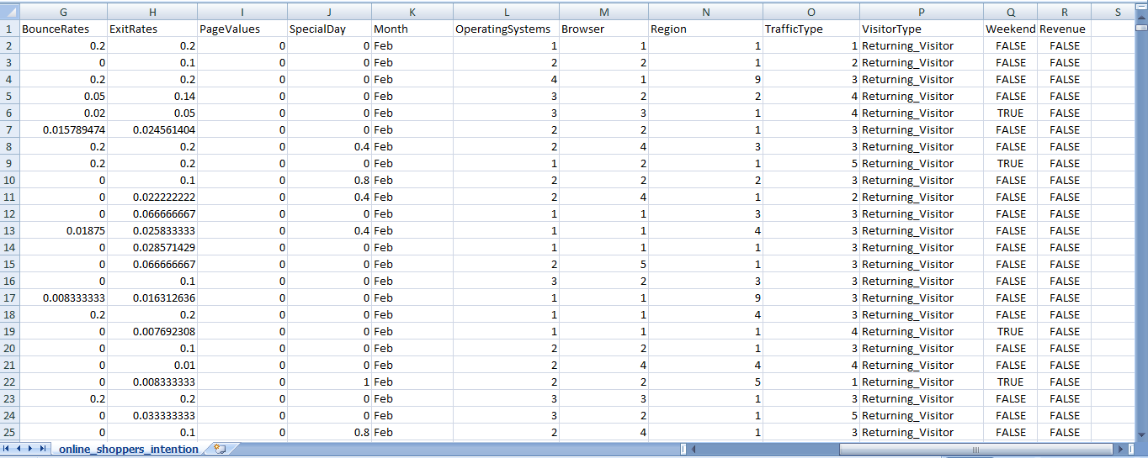
Data Collection
We collect data from kaggle
(https://www.kaggle.com/roshansharma/online-shoppers-intention)
online_shoppers_intention.csv (12,330x18) data in 1-year period

Slide 6
Data Understanding
“Administrative”, “Informational”, and “Product Related” : the amount of pages visited in the categories
“Administrative_Duration”, “Informational_Duration”, and “Product Related_Duration” : the total time spent on each of categories
“BounceRates”, “ExitRates”, “PageValues” : User Engagement KPI from Google Analytics
Notes:
Bounce Rate adalah persentase pengguna yang hanya mengunjungi satu halaman situs tersebut: membuka satu halaman tetapi kemudian keluar tanpa melihat halaman lain di situs tersebut.
Exit Rate adalah persentase orang yang meninggalkan situs dari sebuah halaman; ini termasuk orang-orang yang pernah mengunjungi halaman lain di situs sebelumnya.
Halaman dengan bounce rate tinggi dapat menunjukkan bahwa konten di halaman tersebut tidak seperti yang diharapkan pengguna saat mereka tiba di sana.
Exit rate yang tinggi dapat menunjukkan bahwa halaman ini menyebabkan pengguna berhenti di tengah perjalanan yang dimaksudkan — sebaliknya, jika halaman dengan exit rate yang tinggi adalah halaman terakhir dalam perjalanan, maka exit ratenya adalah tidak masalah sama sekali.
Page Value adalah halaman yang paling memberikan web page direct monetary value. Misalnya, jika pengguna berada dalam halaman tersebut maka pengguna akan memutuskan untuk melakukan transaksi. Halaman dengan nilai page value yang tinggi menunjukkan bahwa halaman ini merupakan halaman yang bagus dan penting dalam situs e-commerce tersebut

Slide 7
Data Understanding
Region : which region the visitor comes from?
Traffic type : user access in certain traffic conditions
Visitor type : New or Old?
Revenue : Is the user contributing on revenue after visiting e-commerce?
Month : list of month of visiting the website
Weekend : is it weekend or not?
Special Day : is it around the special day?
Operating System : type of OS that used by user
Browser : type of browser that used by user

Slide 8
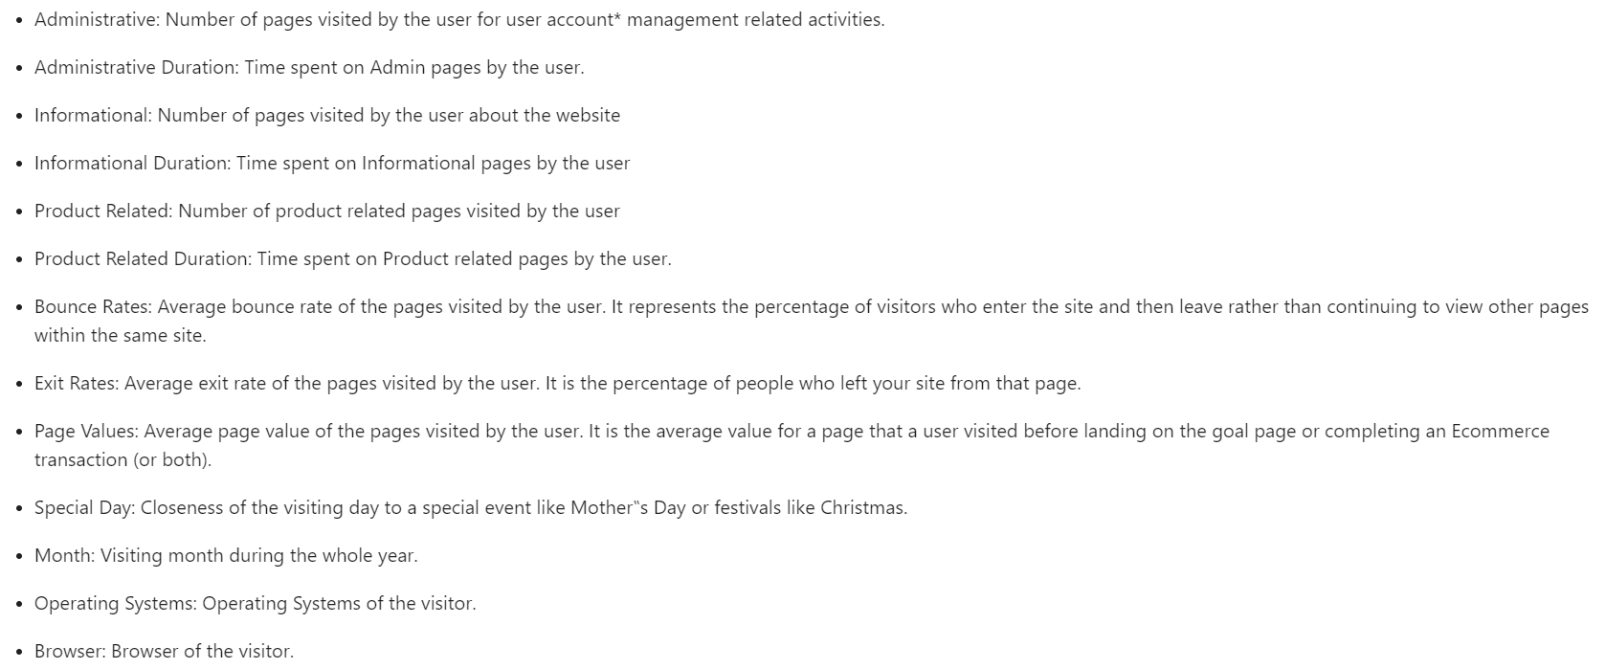
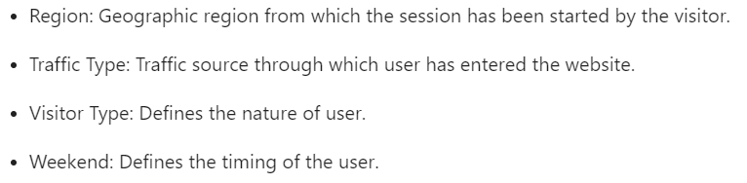

Slide 9
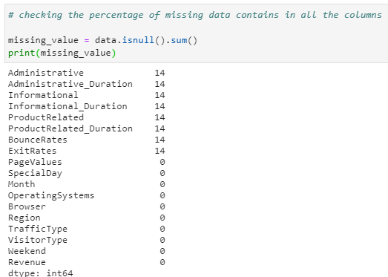
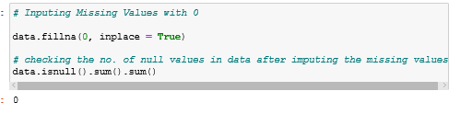
Data Preparation

Slide 10
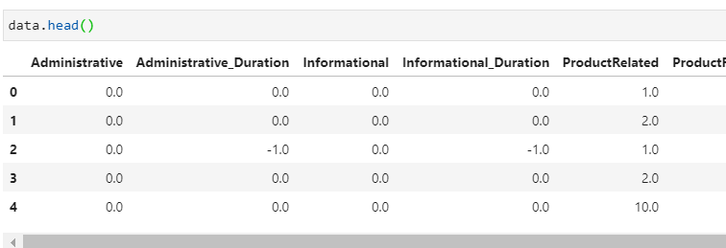
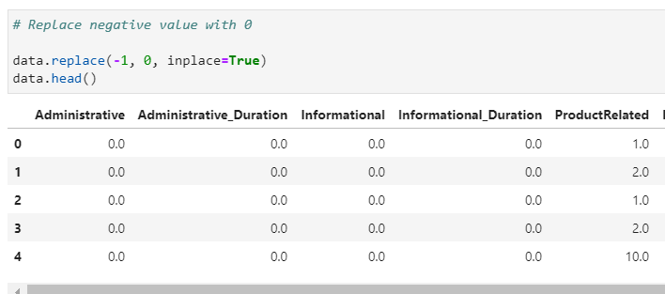
Data Preparation

Slide 11
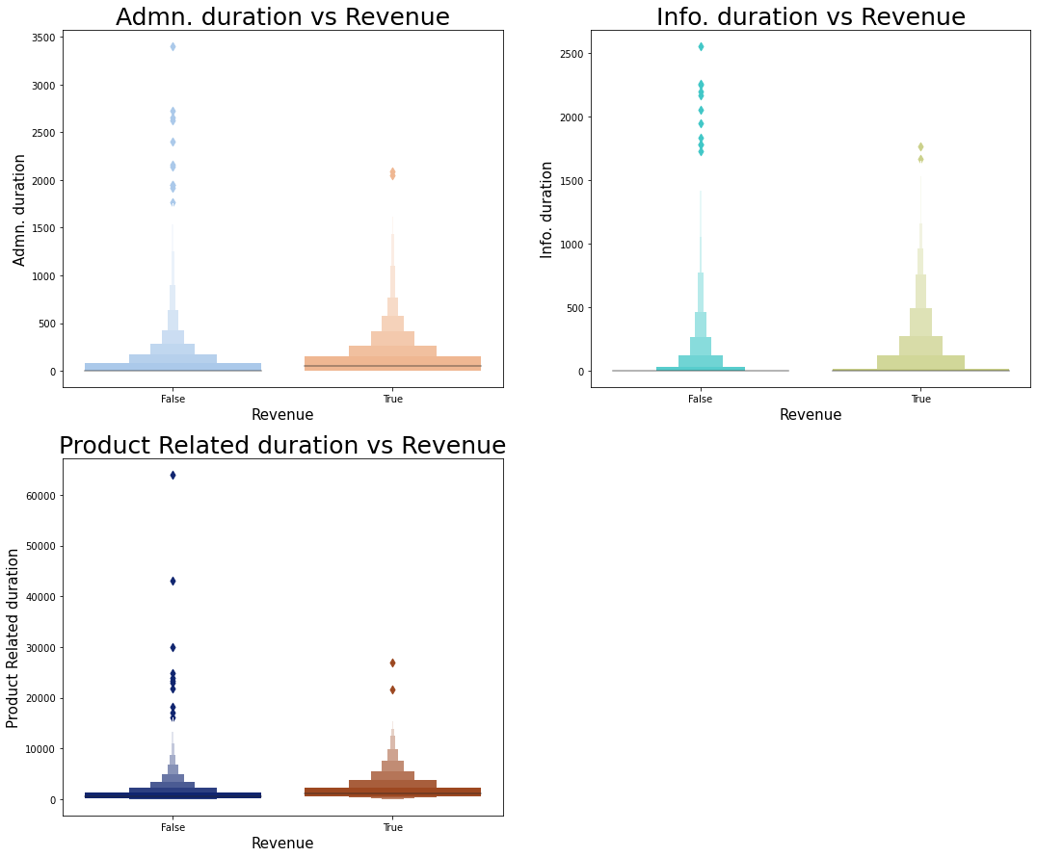
Data Preparation

Slide 12
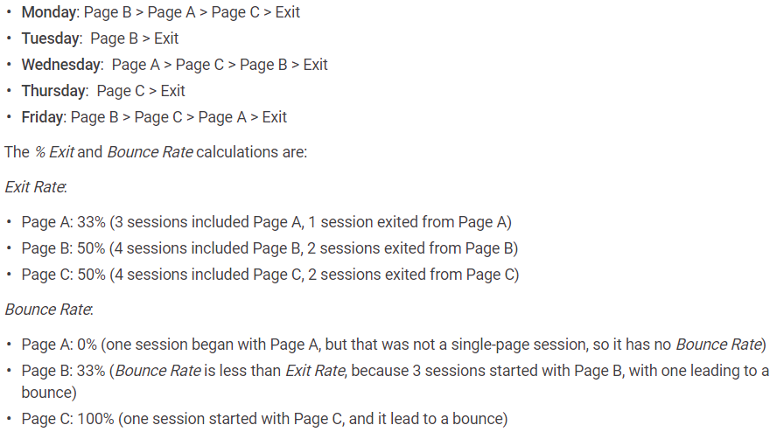
Exit Rates vs Bounce Rate

Slide 13
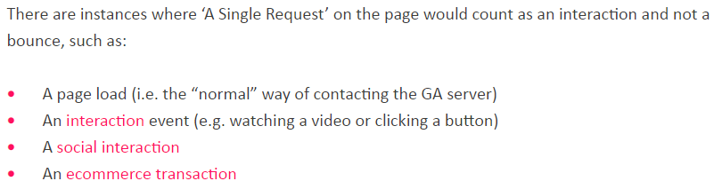

Slide 14
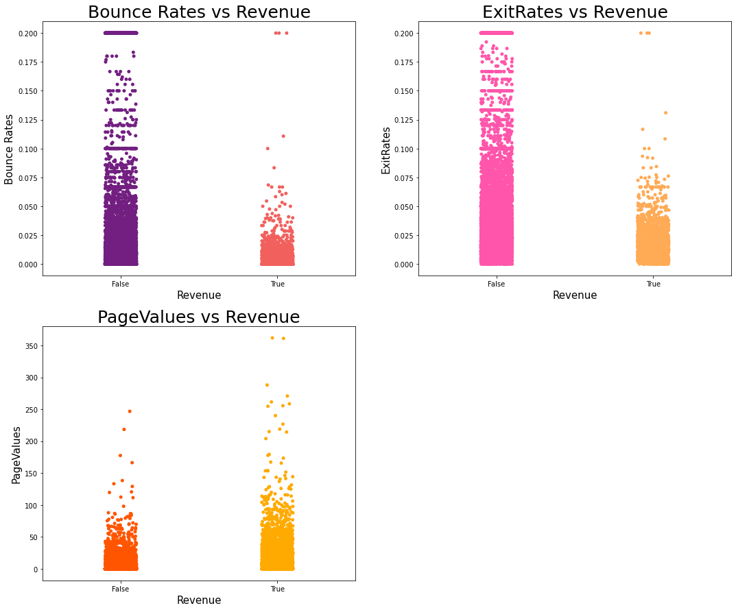
Data Preparation

Slide 15
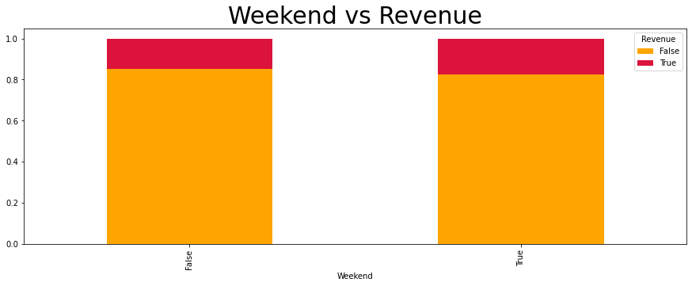
Data Preparation

Slide 16
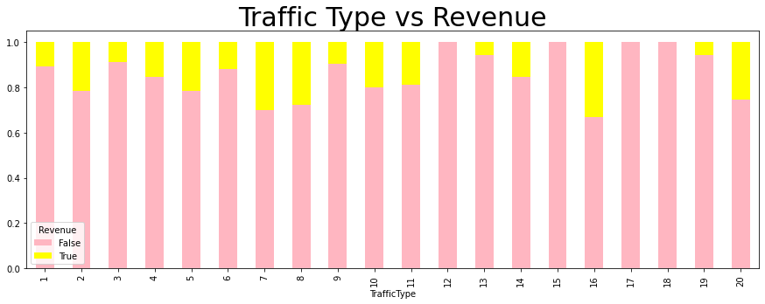
Data Preparation

Slide 17
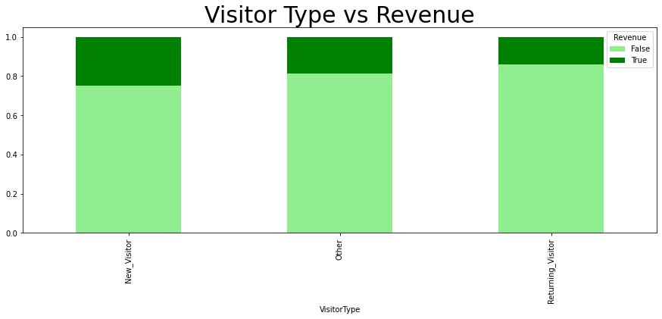
Data Preparation

Slide 18
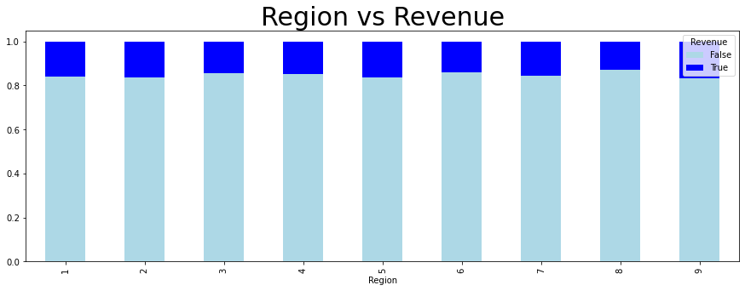
Data Preparation

Slide 19
Modelling
Clustering Analysis:
Trying to learn the user characteristics in terms of time spent without doing anything on the Website
Administrative Duration vs Bounce Rate
Informational Duration vs Bounce Rates
Product Related Duration vs Bounce Rates
*Bounce Rate: The percentage of visitors to a particular website who navigate away from the site after viewing only one page.

Slide 20
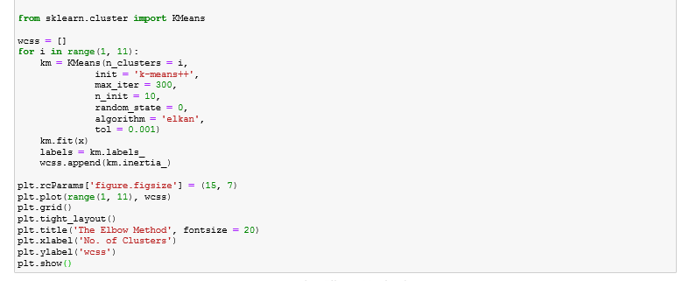
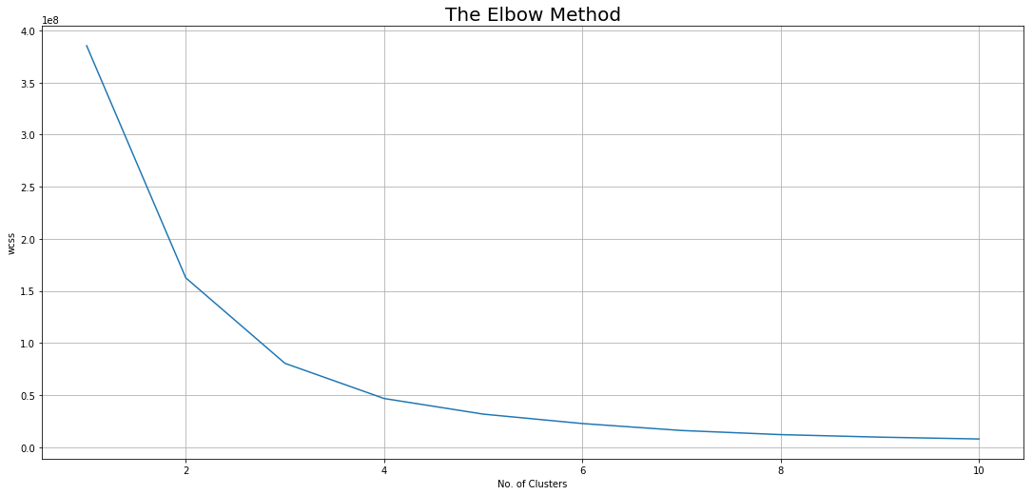
Modelling
Administrative Duration vs Bounce Rate
The Elbow Method to Find out the Maximum no. of Optimal Clusters
Compute clustering algorithm (e.g., k-means clustering) for different values of k. For instance,
by varying k from 1 to 10 clusters

Slide 21
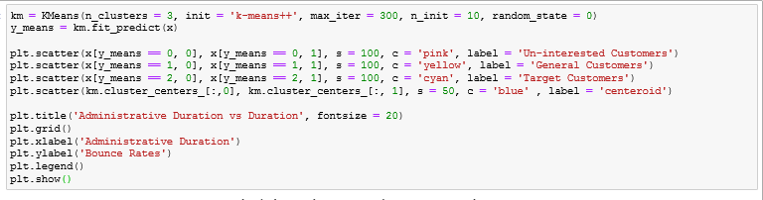
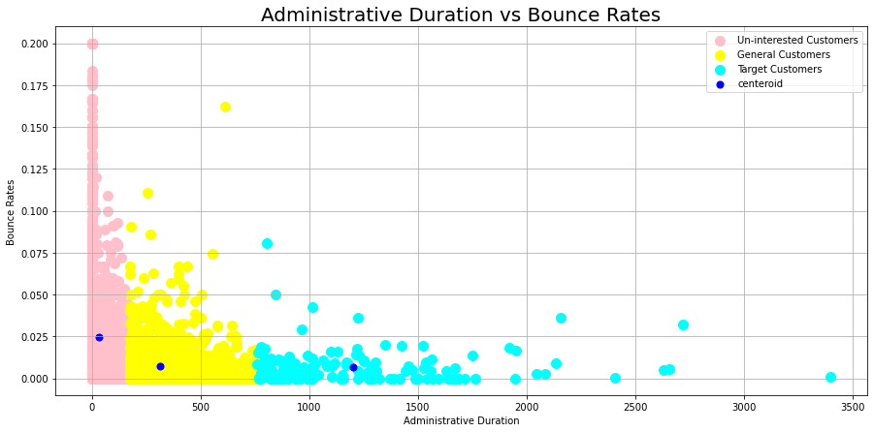
Result

Slide 22
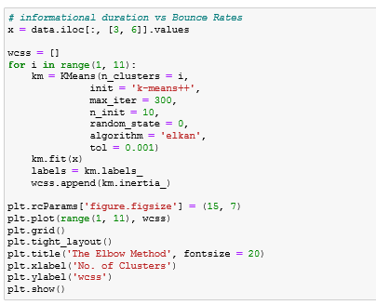
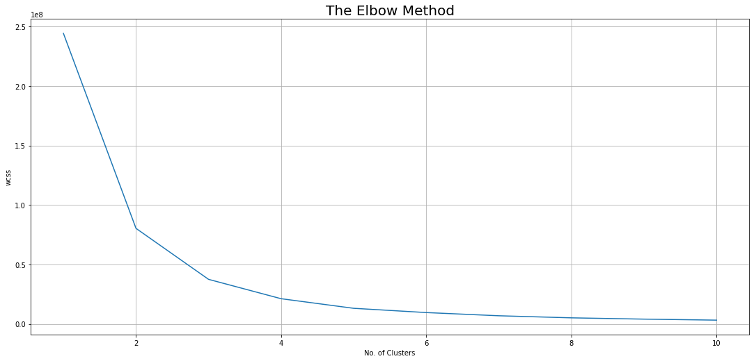
Modelling
2. Informational Duration vs Bounce Rates

Slide 23
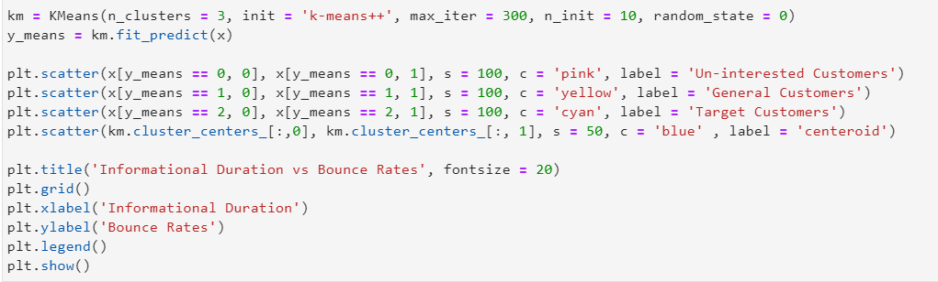
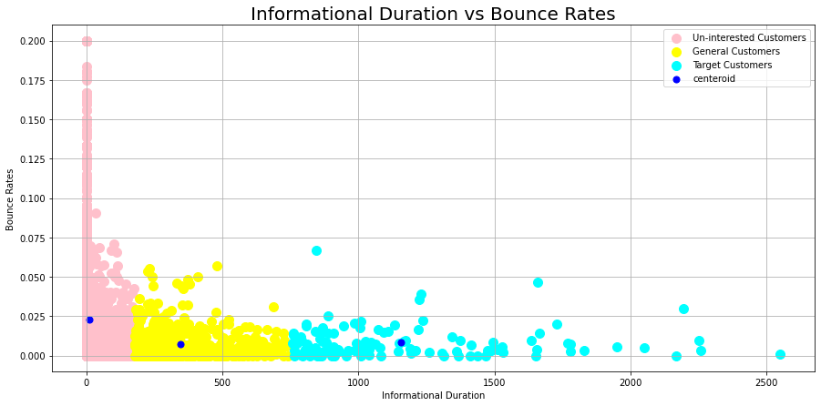
Result

Slide 24
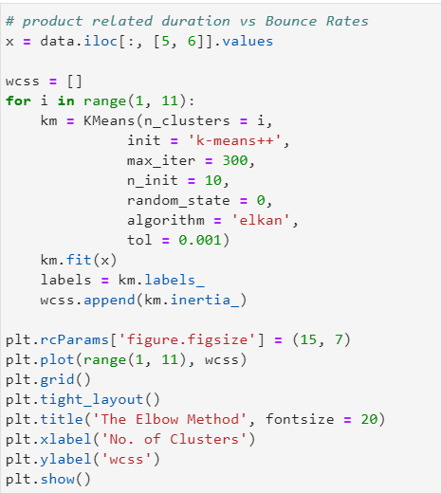
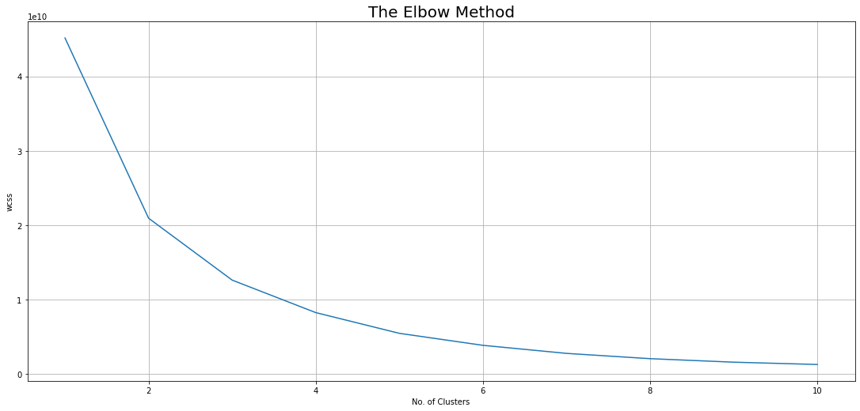
Modelling
3.Product Related Duration vs Bounce Rates

Slide 25
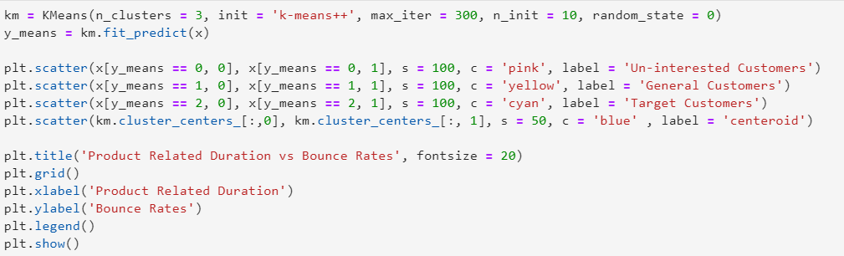
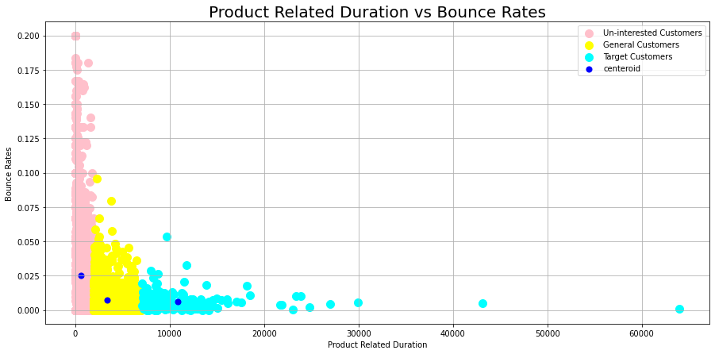
Result

Slide 26
Modelling
Clustering Analysis:
Trying to learn the user characteristics in terms of time spent before leave the Website
Administrative Duration vs Exit Rate
Informational Duration vs Exit Rates
Product Related Duration vs Exit Rates
*Exit Rate: Average exit rate of the pages visited by the user. It is the percentage of people who left your site from that page.

Slide 27
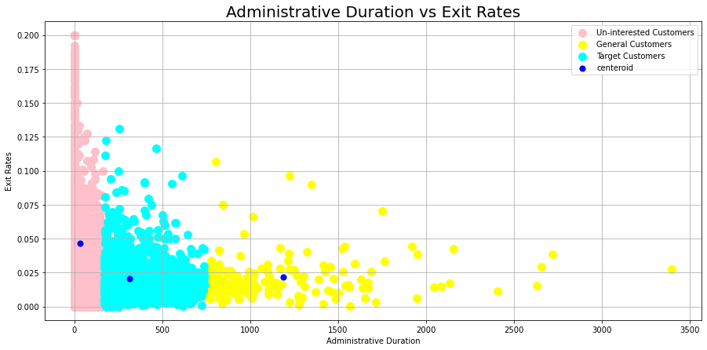
Modelling
1. Administrative Duration vs Exit Rates

Slide 28
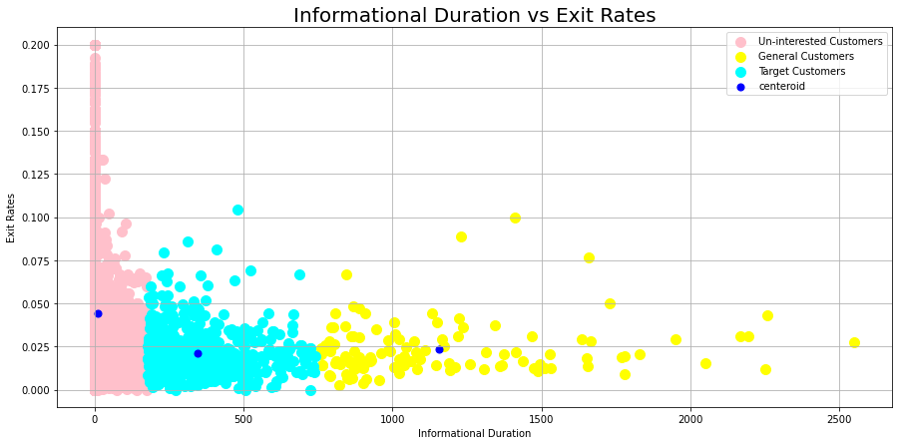
Result
2. Informational Duration vs Exit Rates

Slide 29
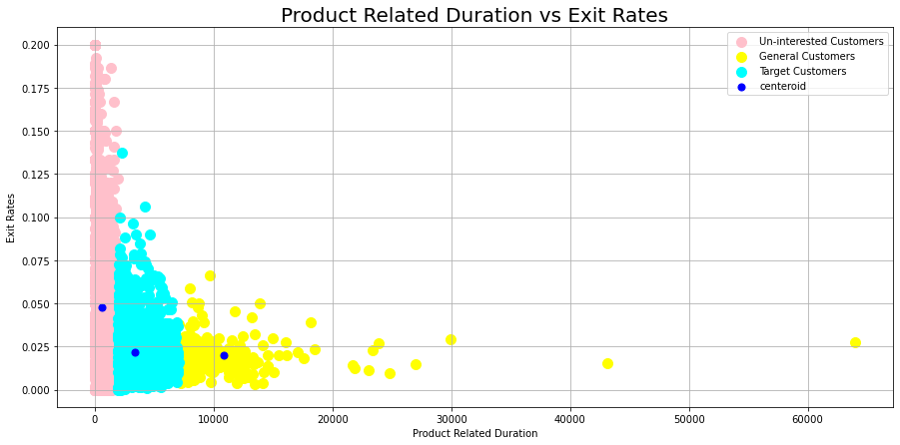
Modelling
3. Product Related Duration vs Exit Rates

Slide 30
Un-interested customers have a high bounce rates and high exit rates in all type of pages and spent little duration on those pages.
Target customers have a low bounce rates and low exit rates in all type of pages and spent moderate duration on those pages.

Slide 31
TERIMA KASIH

